Slide 1
CMF Clearinghouse Use Case – CTDOT/UCONN CRSMS
SHANSHAN ZHAO
Connecticut Transportation Safety Research Center, UCONN

Slide 2



Project Background

Slide 3
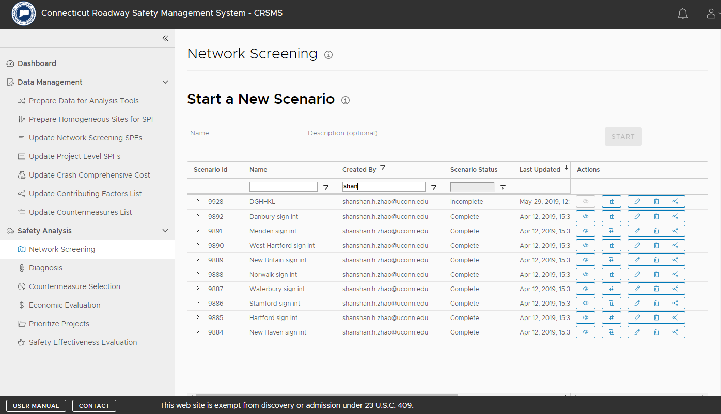
Connecticut Roadway Safety Management System (CRSMS)

Slide 4
Before Implementing Countermeasure Selection …
Network Screening
Diagnosis

Slide 5
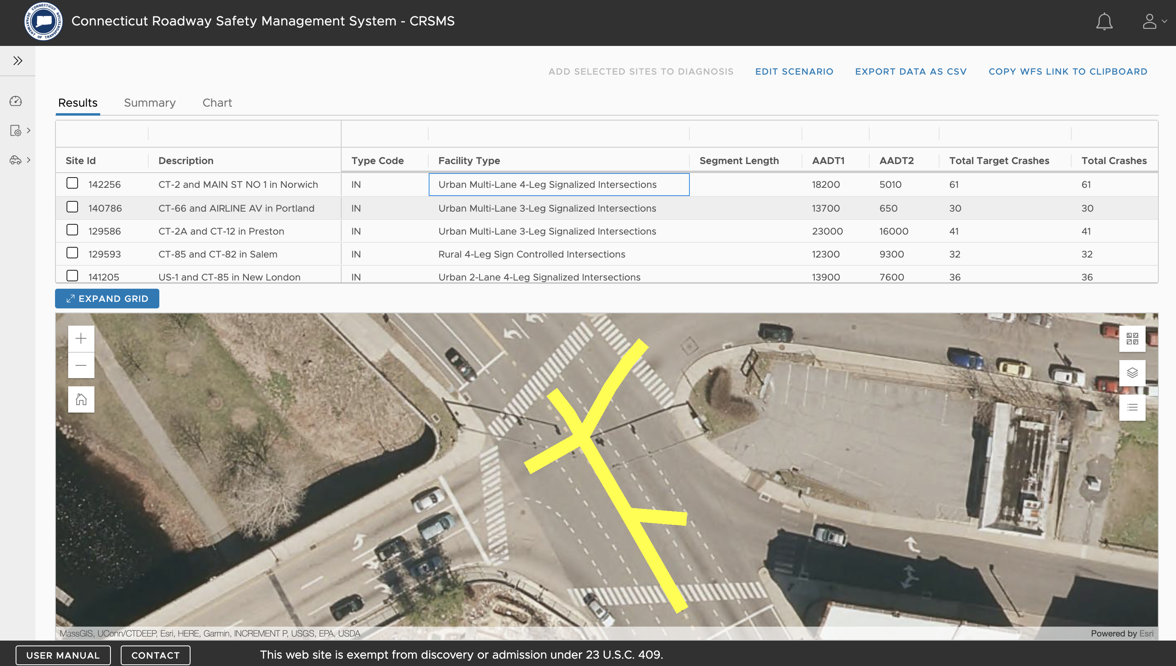

Slide 6
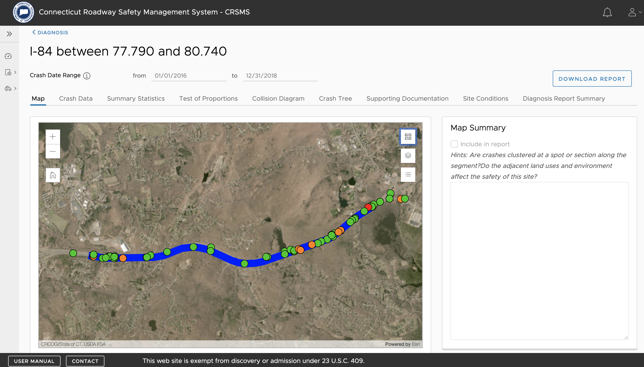

Slide 7
Countermeasure Selection Module Implementation

Slide 8
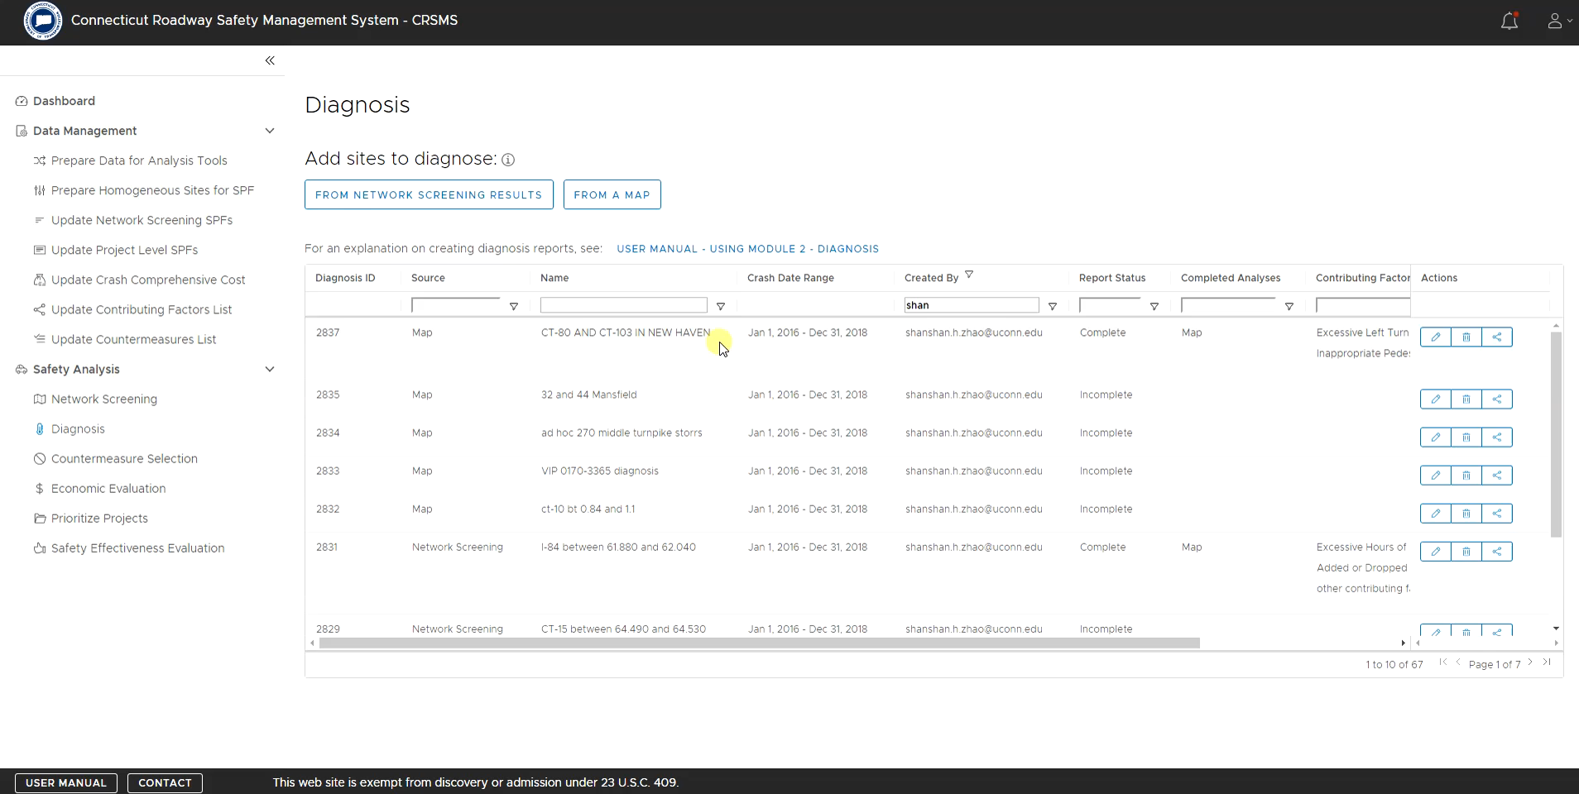

Slide 9
After Implementing Countermeasure Selection …
Economic Analysis
Project Prioritization
Safety Effectiveness Evaluation

Slide 10
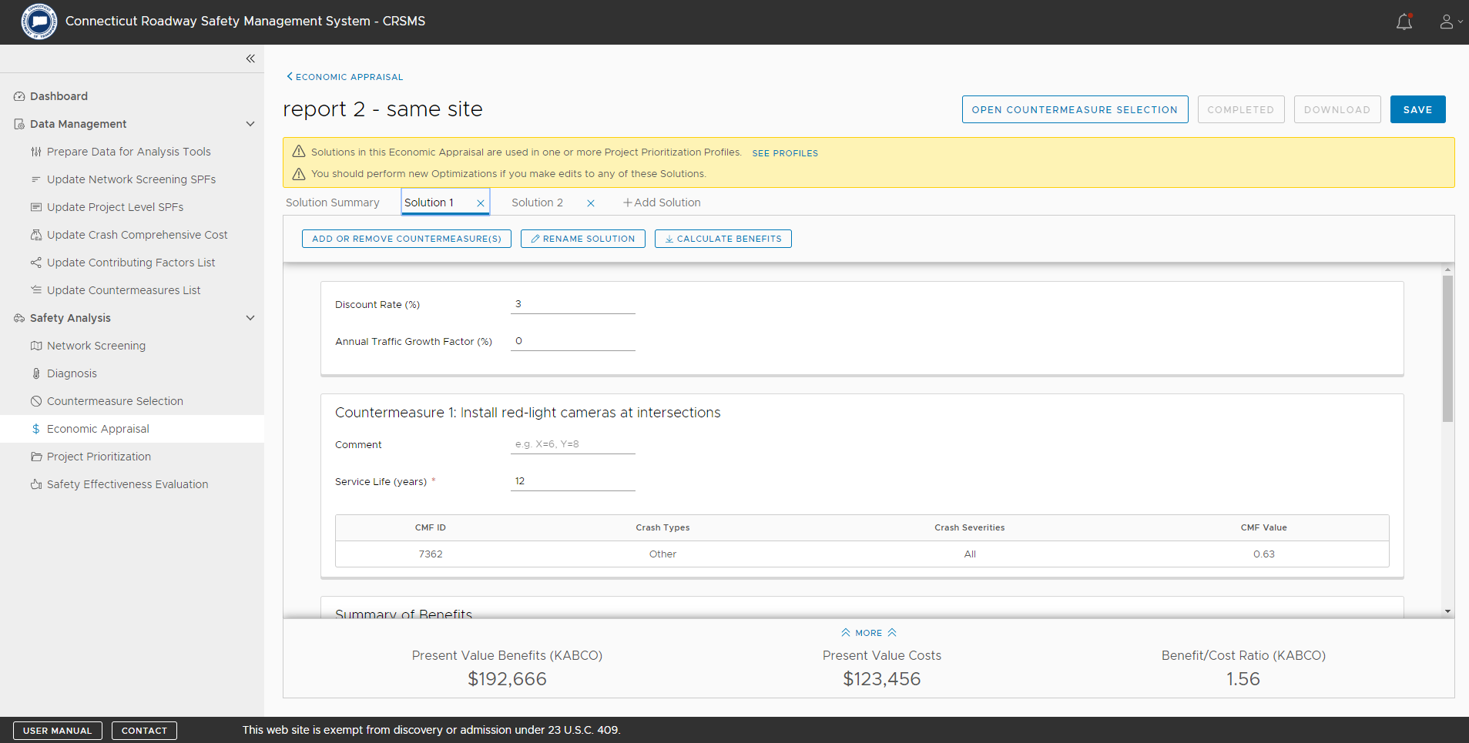

Slide 11
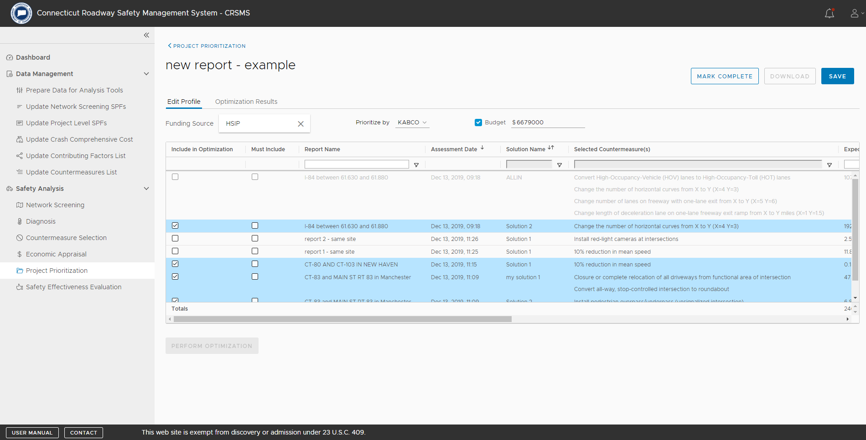

Slide 12
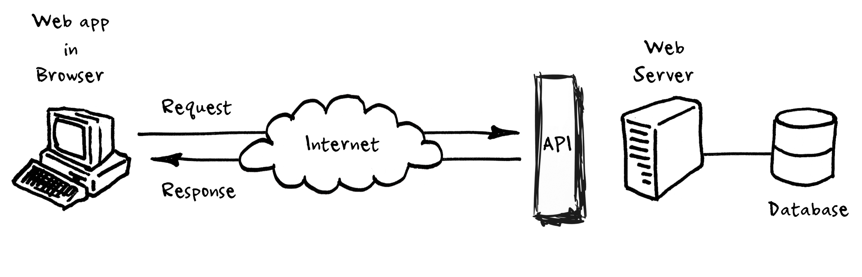
CMF Clearinghouse API
Web-based API that returns data in response to a request made by a client
(Perry Eising, https://medium.com/@perrysetgo/what-exactly-is-an-api-69f36968a41f)
CMF CH API: JSON, XML, EXCEL, etc.

Slide 13
CMF Clearinghouse API (Cont.)
Parse the data using the .NET OpenXml library into a hierarchical structure
Populate a database table with a copy of the downloaded data
Execute a database routine that
  Recognize the hierarchical format
  Update CMFs that already exist
  Add new CMFs that do not exist
Allow custom CMFs and prevent overwritten

Slide 14
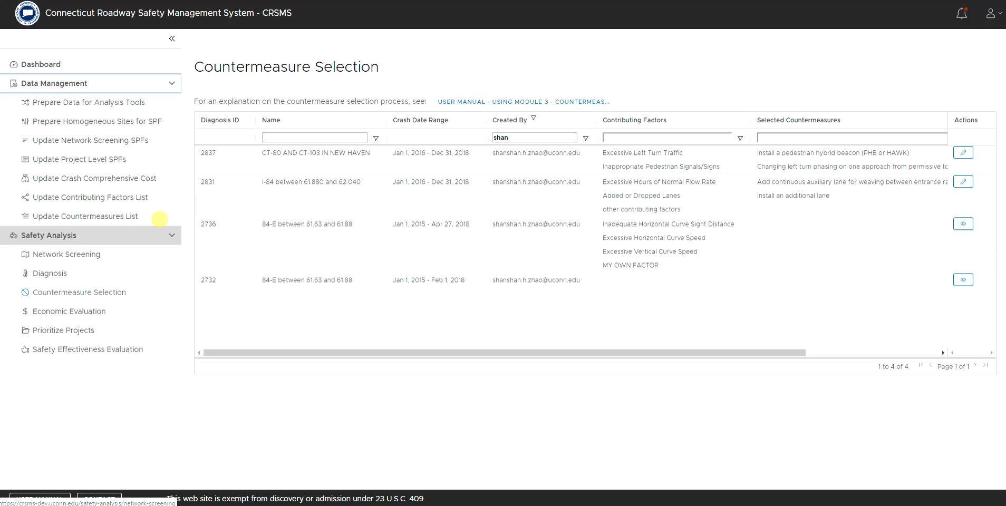

Slide 15


Contact
  Shanshan Zhao, Ph.D.
  Connecticut Transportation Safety Research Center
  shanshan.h.zhao@uconn.edu

